Slide 1
Predictions
Dr. Farhan Hussain

Slide 2
Pipeline and Branches
Branch
BEQ R1, R2, Label
If (R1!=R2) just PC++
If (R1==R2) then PC+4+Offset
Resolved in 3rd stage or can be resolved in 2nd stage
Fecth | Dedcode | ALU | MEM | WR
BEQ
 | BEQ
 |  | BEQ

Slide 3
Branch Prediction
We only know PC of current instruction
What is the value of PC for the next instruction to be fetched
We have to guess
Is this a branch instruction?
Is it taken?
If taken, what is the target PC?

Slide 4
Branch Prediction
We only know PC of current instruction
What is the value of PC for the next instruction to be fetched
We have to guess
Is this a branch instruction?
Is it taken?
If taken, what is the target PC?
Is this a taken branch
Actually Boils down to a single decision

Slide 5
Branch Prediction Accuracy
CPI=1+ Misprediction/Instructions × Penalty/Misprediction
Generally, 20% of all Instructions are branches
ACCURACY | BRANCH RESOVED IN 3RD STAGE | BRANCH RESOVED IN 10Th STAGE
50% for branch instructions 100% for all other instructions
90% for branch instructions 100% for all other instructions

Slide 6
Branch Prediction Accuracy
CPI=1+ Misprediction/Instructions × Penalty/Misprediction
Generally, 20% of all Instructions are branches
ACCURACY | BRANCH RESOVED IN 3RD STAGE | BRANCH RESOVED IN 10Th STAGE
50% for branch instructions 100% for all other instructions | 1+0.5×0.2×2=1.2 | 1+0.5×0.2×9=1.9
90% for branch instructions 100% for all other instructions | 1+0.1×0.2×2=1.2=1.04 | 1+0.1×0.2×9=1.18

Slide 7
Advantages of Branch Prediction
LOOP: ADD F1, F1, -1
ADD F2, F2, F2
BNEZ F1, Loop
without predictions ?
With predictions ?

Slide 8
Advantages of Branch Prediction
LOOP: ADD F1, F1, -1 2 1
ADD F2, F2, F2 2 1
BNEZ F1, Loop 3 1
without predictions ? 7
With predictions ? 3

Slide 9
Prediction: Branches Always not Taken
No prediction at all
Branch would take 3 cycles or 2 cycles
Non branch would take 2 cycles
Always using not taken prediction
Branch would take 1 or 3 cycle
Non branch would always take one cycle

Slide 10
Not Taken Prediction
Simplest predictor possible
Just increment PC (No memory required no Extra hardware)
Accuracy
Almost 88 % (How: 20% of the instructions are branches and 60% of them are taken)

Slide 11
Multiple Predictions
BNE R1, R4, Label A
BNE R1, R3, Label B
A
B
C
Label A
X
Y
Label B:
z
Branch Resolved
Fetch | Decode | ALU | MEM | WR
Using Not-taken predicator (but both branches are taken) how many cycles are wasted on misprediction until we get to Y

Slide 12
Analysis of Branch Prediction
 | Not Taken (88%) | 99% Predictor | Speedup
5 Stage pipeline (branch resolved in 3rd stage)
14-stage pipeline (branch resolved in 11th stage)
14-stage pipeline (branch resolved in 11th stage) 4-instructions per cycle

Slide 13
Analysis of Branch Prediction
 | Not Taken (88%) | 99% Predictor | Speedup
5 Stage pipeline (branch resolved in 3rd stage) | 1+0.12*2=1.24 | 1+0.01*2=1.02 | 1.21
14-stage pipeline (branch resolved in 11th stage) | 1+0.12*10=2.2 | 1+0.01*10=1.1 | 2
14-stage pipeline (branch resolved in 11th stage) 4-instructions per cycle | 0.25+0.12*10=1.45 | 0.25+0.001*10=0.35 | 4.14

Slide 14
Cost of Misprediction in terms of Instruction wasted
05 stage pipeline with branches resolved in 3rd stage
05 stage pipeline with branches resolved in 2nd stage
14 stage pipeline with branches resolved in 11th stage
Superscalar processor with 4 instructions per cycle with branches resolved in 11th cycle

Slide 15
Some Pentium 4 Processor
Fetch -------------29th stage, branch resolved in 30th cycle, ………..
Utilizes branch prediction
Multiple instructions /cycle
20% of the instructions are branches
1% of branches are mis predicted
Actual CPI is 0.5
What is the perfect CPI

Slide 16
Branch Target Buffers

Slide 17
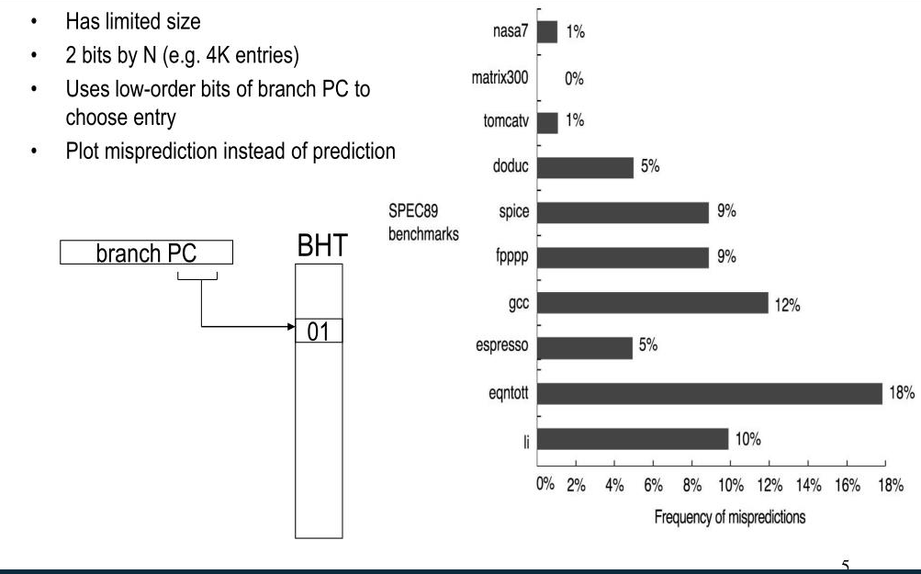
Branch History Tables

Slide 18
Branch Target Buffers
BTB has 1024 entries (0,1,2,3,….1024)
Fixed size 4-byte instructions, word aligned (0,4,8,12,16,….)
32-bit address
Which BTB entry is used for PC=0x0000AB0C

Slide 19
Branch Target Buffer & Branch History Table
BHT=16 entries, perfect prediction
BTB=4, entries, perfect prediction
How many times we access the BHT for each instruction
Which BHT entry do we access for each instruction
How many times we access the BTB for each instruction
Which BTB entry we access for each instruction

Slide 20
Branch Target Buffer & Branch History Table
0xC000 | MOV R2,100
0xC004 | MOV R1, 0
0xC008 | Loop: BEQ R1,R2, done
0xC00C | ADD R4, R3, R1
0xC010 | LW R4, 0(R4)
0xC014 | ADD R5, R5, R4
0xC018 | ADD R1, R1, 1
0xC01C | J loop
0xC020 | Done

Slide 21
Branch Target Buffer & Branch History Table
0xC000 | MOV R2,100 | 1 | 0000 0000 0000 (0) | 0
0xC004 | Mov R1, 0 | 1 | 0000 0000 0100 (1) | 0
0xC008 | Loop: BEQ R1,R2, done | 101 | 0000 0000 1000 (2) | 0 →1
0xC00C | ADD R4, R3, R1 | 100 | 0000 0000 1100 (3) | 0
0xC010 | LW R4, 0(R4) | 100 | 0000 0001 0000 (4) | 0
0xC014 | ADD R5, R5, R4 | 100 | 0000 0001 0100 (5) | 0
0xC018 | ADD R1, R1, ` | 100 | 0000 0001 1000 (6) | 0
0xC01C | J loop | 100 | 0000 0001 1100 (7) | 100
0xC020 | Done

Slide 22
Branch Target Buffer & Branch History Table
0xC000 | MOV R2,100 | 1 | 0000 0000 0000 (0)
0xC004 | Mov R1, 0 | 1 | 0000 0000 0100 (1)
0xC008 | Loop: BEQ R1,R2, done | 101 | 0000 0000 1000 (2) | 0000 0000 1000 (2)
0xC00C | ADD R4, R3, R1 | 100 | 0000 0000 1100 (3)
0xC010 | LW R4, 0(R4) | 100 | 0000 0001 0000 (4)
0xC014 | ADD R5, R5, R4 | 100 | 0000 0001 0100 (5)
0xC018 | ADD R1, R1, ` | 100 | 0000 0001 1000 (6)
0xC01C | J loop | 100 | 0000 0001 1100 (7) | 0000 0001 1100 (7)
0xC020 | Done

Slide 23
Branch Target Buffer & Branch History Table
BHT=16 entries, 1 bit predictor (starts with branch not taken)
BTB=4, entries, perfect prediction
How many misprediction for each instructions

Slide 24
Branch Target Buffer & Branch History Table
0xC000 | MOV R2,100
0xC004 | MOV R1, 0
0xC008 | Loop: BEQ R1,R2, done
0xC00C | ADD R4, R3, R1
0xC010 | LW R4, 0(R4)
0xC014 | ADD R5, R5, R4
0xC018 | ADD R1, R1, `
0xC01C | J loop
0xC020 | Done

Slide 25
Branch Prediction
Static Predictors
Dynamic Predictors
History predictors
Correlator predictors
Tournament predictors

Slide 26
Static Branch Prediction
Assume that a branch is always
TAKEN
OR
NOT TAKEN

Slide 27

One Bit Prediction

Slide 28
Two Bit Prediction

Slide 29
One Bit Prediction Vs. Two Bit Prediction
Predictor | Branch outcome | Mis prediction
 | T
 | T
 | T
 | N
 | T
 | N
 | T
 | T
 | T
 | N
 | T
 | N
 | T
 | T
 | T
 | N
 | T
 | N

Slide 30
One Bit Prediction Vs. Two Bit Prediction
Predictor | Branch outcome | Mis prediction
 | T
 | T
 | T
 | N
 | T
 | N
 | T
 | T
 | T
 | N
 | T
 | N
 | T
 | T
 | T
 | N
 | T
 | N

Slide 31
Correlating Branch Predictors
if (aa==2)
aa=0;
if (bb==2)
bb=0;
if (aa!=bb) {
DADDIU R3,R1,#–2
BNEZ R3,L1 ;branch b1 (aa!=2)
DADD R1,R0,R0 ;aa=0
L1: DADDIU R3,R2,#–2
BNEZ R3,L2 ;branch b2 (bb!=2)
DADD R2,R0,R0 ;bb=0
L2: DSUBU R3,R1,R2 ;R3=aa-bb
BEQZ R3,L3 ;branch b3 (aa==bb)

Slide 32
Correlating Branch Predictors
if ( d==0 )
d = 1;
if ( d==1 )
…
BNEZ R1, L1 ;branch b1 (d!=0)
DADDIU R1, R0, #1 ; d==0, so d==1
L1: DADDIU R3, R1, #-1
BNEZ R3, L2 ;branch b2 (d!=1)
…
L2:

Slide 33
Correlating Branch Predictors
Initial Value of d | d==0? | b1 | Value of d before b2 | d==1? | b2
0 | yes | Not taken | 1 | yes | Not taken
1 | no | Taken | 1 | yes | Not taken
2 | no | Taken | 2 | no | Taken

Slide 34
Correlating Branch Predictors
d=? | b1 prediction | b1 action | New b1 prediction | B2 prediction | B2 action | New b2 prediction
2 | NT | T | T | NT | T | T
0 | T | NT | NT | T | NT | NT
2 | NT | T | T | NT | T | T
0 | T | NT | NT | T | NT | NT

Slide 35
Correlating Branch Predictors
Prediction Bits | Prediction if last branch is NOT taken | Prediction if last branch is taken
NT/NT | NT | NT
NT/T | NT | T
T/NT | T | NT
T/T | T | T

Slide 36
Correlating Branch Predictors
d=? | b1 prediction | b1 action | New b1 prediction | B2 prediction | B2 action | New b2 prediction
2 | NT/NT | T | T/NT | NT/NT | T | NT/T
0 | T/NT | NT | T/NT | NT/T | NT | NT/T
2 | T/NT | T | T/NT | NT/T | T | NT/T
0 | T/NT | NT | T/NT | NT/T | NT | NT/T

Slide 37
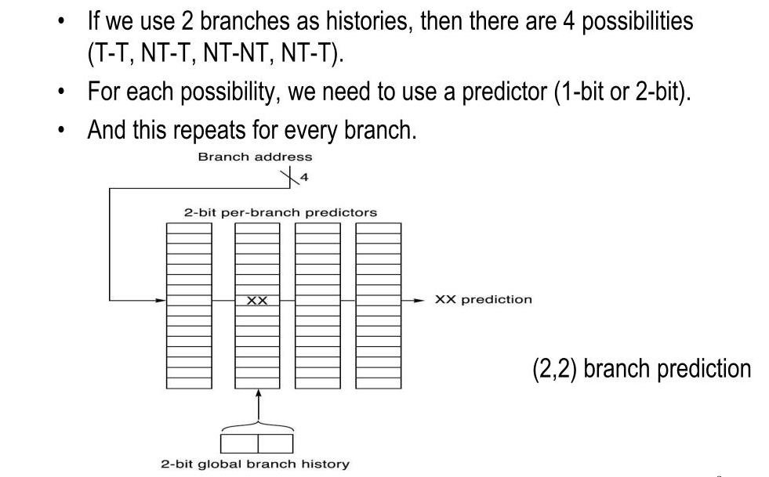
Hardware
How many bits are in this branch predictor

Slide 38

$(m,n)$ Corelated Branch Predictors
How many bits are in the (0,2) branch predictor with 4K entries?
The predictor with 4K entries has
2⁰ × 2 ×4K = 8K bits
How many branch-selected entries are in a (2,2) predictor that has a total of 8K×bits in the prediction buffer?
2² × 2 ×Number of prediction entries selected by the branch = 8K
Hence, the number of prediction entries selected by the branch = 1K.

Slide 39

$(m,n)$ Corelated Branch Predictors
The number of bits in an (m,n) predictor is
$2m × n × Number of prediction entries selected by the branch address$

Slide 40
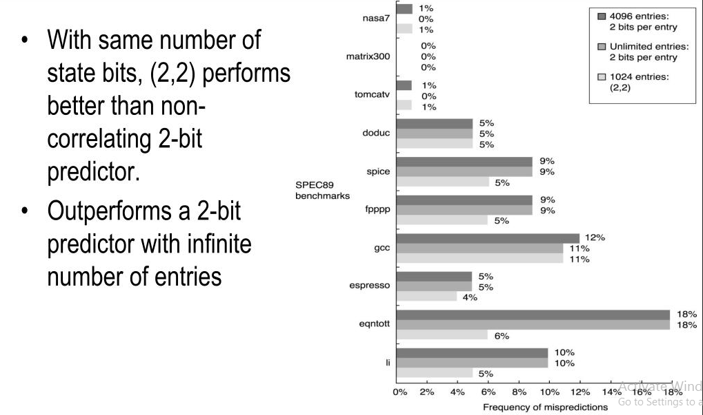
Performance of Corelating Branch Predictor

Slide 41
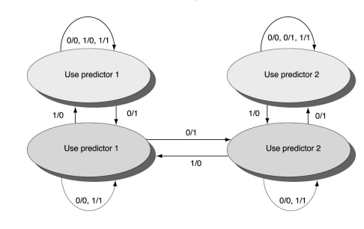
Tournament Predictors

Slide 42
The Intel Core i7 Branch Predictor
Intel has released only limited amounts of information about the Core i7’s branch predictor, which is based on earlier predictors used in the Core Duo chip. The i7 uses a two-level predictor that has a smaller first-level predictor, designed to meet the cycle constraints of predicting a branch every clock cycle, and a larger second-level predictor as a backup. Each predictor combines three different predictors: (1) the simple two-bit predictor, which was introduced in Appendix C (and used in the tournament predictor discussed above); (2) a global history predictor, like those we just saw; and (3) a loop exit predictor. The loop exit predictor uses a counter to predict the exact number of taken branches (which is the number of loop iterations) for a branch that is detected as a loop branch. For each branch, the best prediction is chosen from among the three predictors by tracking the accuracy of each prediction, like a tournament predictor. In addition to this multilevel main predictor, a separate unit predicts target addresses for indirect branches, and a stack to predict return addresses is also used.

